Slide 1

Developing Web Applications to Support Data Analysis by Visual Programming
6th International Conference on Business Management of Technology (BMOT 2021)
July 11- 16, 2021
Koji Okuhara¹ and Antonio Oliveira Nzinga Rene¹
¹ Toyama Prefectural University
Sponsor
International Institute of Applied Informatics

Slide 2
Introduction
Background of this study
The purpose of this research is to develop a programming environment easy to use for the general public by using visual programming to reduce a program written in an extended source code into a single block. Additionally, we developed a system allowing clients to understand the analysis a selected block performs by describing the block on the system.
Purpose of this study
A data scientist is a person capable of extracting valuable knowledge from data and applying it to corporate decision-making, rather than merely aggregating and processing data within a company or organization. However, there is no clear definition of a 'data scientist.’ In this research, we developed a system with data analysis functions. We can obtain data analysis results in real-time by simply clicking a mouse or a button on a website.

Slide 3
Agenda
This paper is structured as follows. After this introduction,
Section 2 introduces the research's background and purpose, describing human society's history and the challenges for managing information from conventional society to Society 5.0 and the basic knowledge needed for this research, such as server-side programs and visual programming.
Section 3 describes and explains the path and details from the server's selection to the study's environment, and the server's OS, programming language, and security are explained.
A system combining data analysis and a visual programming language is proposed in Section 4. The section also describes data structures, system structure, and various functions required for data analysis.
Section 5 outlines the experiment, results, and discussion, respectively.
Section 6 summarizes the study and discusses future work, including necessary improvements for the system.

Slide 4

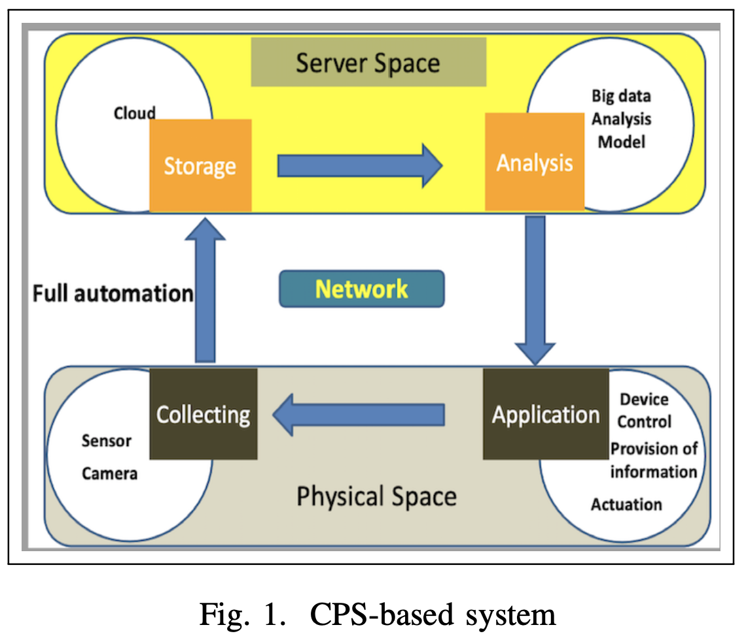
Web Applications in Cyber-Physical Systems
Digital Transformation and Society 5.0
The words cyber-physical systems (CPS) have been heard more and more frequently. CPS are systems that collect, process, and utilize data obtained from the real world.
The systems contribute to all social systems' efficiency, creating new industries and intellectual productivity improvement. They also connect cyberspace and physical space employing networks, as shown in Figure 1.

Slide 5

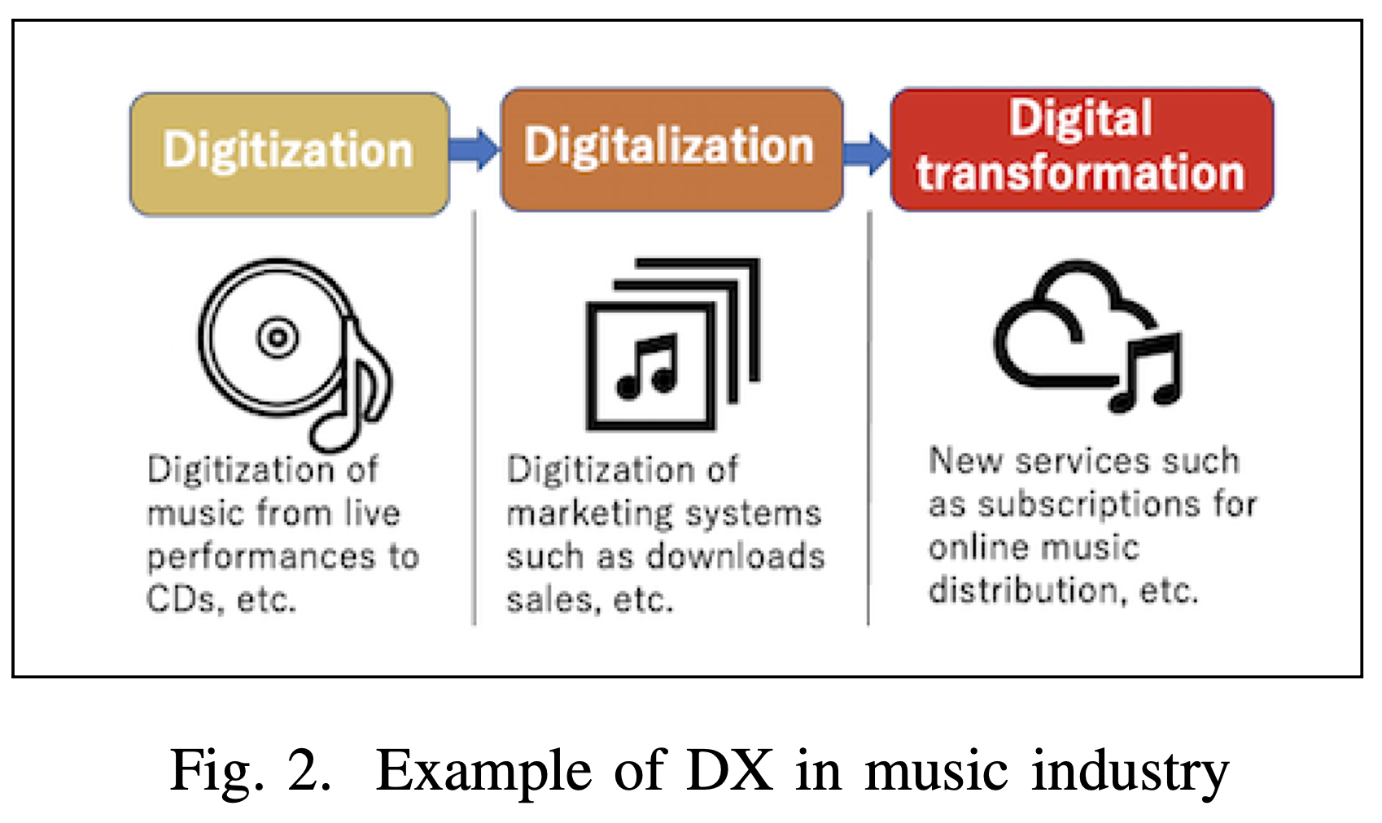
Web Applications in Cyber-Physical Systems
Example of DX
The concept at the beginning of DX was that "ever-evolving technology will improve our lives", i.e., the concept applies not only for corporations but for all the technology.
Digitization represents the conversion of data into a different format, for instance, letters to emails, human work to artificial intelligence work, that is, the transformation of digital technology into something more efficient. At the same time, digitalization refers to the digitization of business models. Therefore, as shown in Figure 2, digitization of things is the preliminary stage of digitalization.

Slide 6
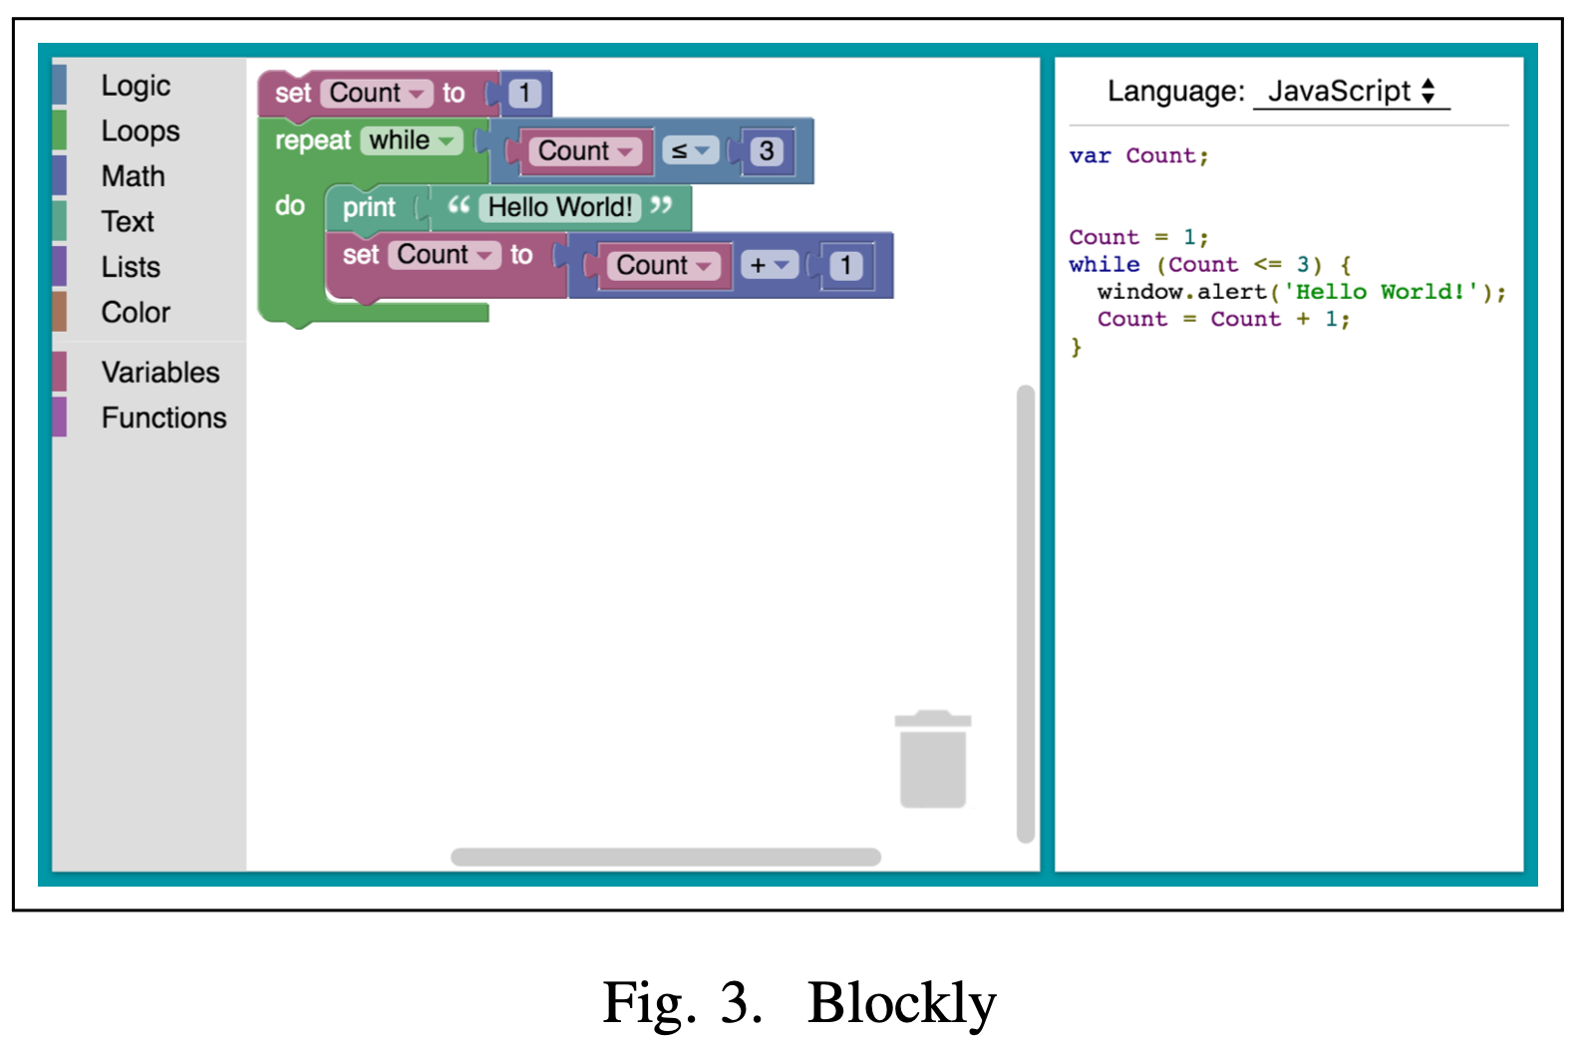
Web Applications in Cyber-Physical Systems
Essential Information and Technology for Server-side Programs
Server-side technology refers to programs such as PHP and Perl running on the server and the database. For example, in a lodging reservation site, data inserted by a user is sent to the server. The server-side technology searches for room availability information in the database returns the results, or stores the user's information in the database and saves it as reservation information.
Visual Programming
Block-type visual programming is similar to the idea of a text language and is considered most suitable for programming education. Figure 3 shows Blockly, a block-type visual programming language.

Slide 7
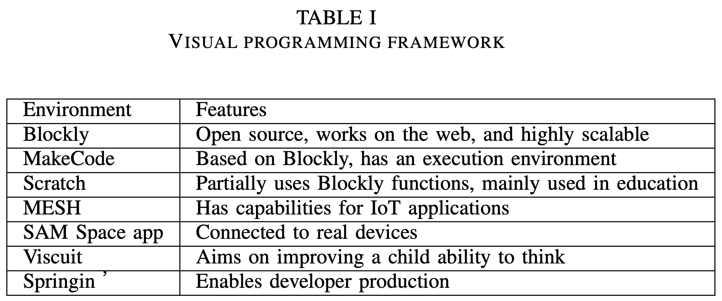
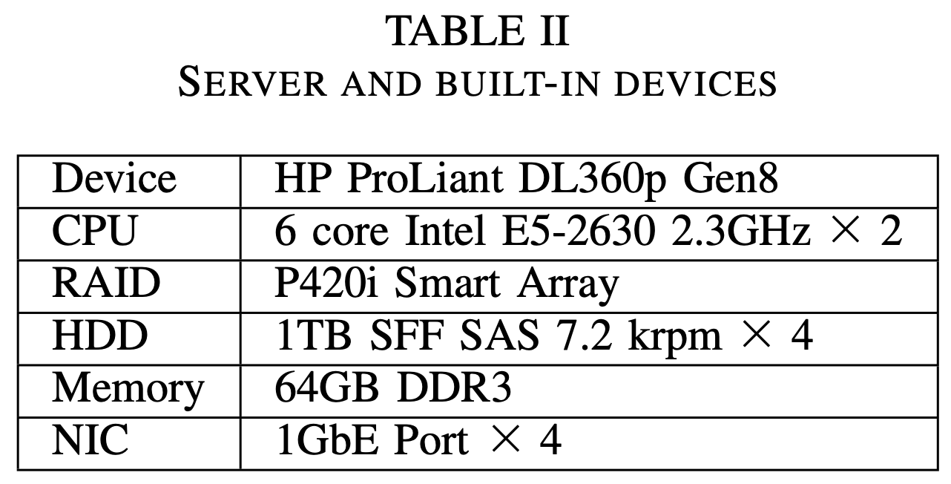
Information Technology Required to Develop the Web Application
Selection and Configuration of Servers
This study uses Blockly, whose description is presented in Table 1 as the visual programming framework for being highly scalable and can run on the web.
This describes the process to select a physical server, and its implementation in the environment of the proposed system. As shown in Table 2, this study employs onpremise for scalability.

Slide 8
Information Technology Required to Develop the Web Application
Security for Servers
The following described the security measures we have implemented for the server.
・File tampering detection system: a file tampering detection system detects additions, changes, and deletions of files in the system and detects file tampering caused by unauthorized access. We installed Tripwire as a file tampering detection system.
・Rootkit detection tool: a rootkit is a software package necessary for an attacker who has successfully gained unauthorized access to a server to operate remotely after an intrusion. We introduced chkrootkit as a rootkit detection tool.
・Anti-virus software: anti-virus software is software that detects and removes computer viruses. We use Clam AntiVirus as anti-virus software. Clam AntiVirus is an open-source and cross-platform.
・Log monitoring tool: a log monitoring tool analyzes a considerable amount of logs collected from several services on a server and shows easy-to-understand results. We employed Logwatch as a log monitoring tool.

Slide 9
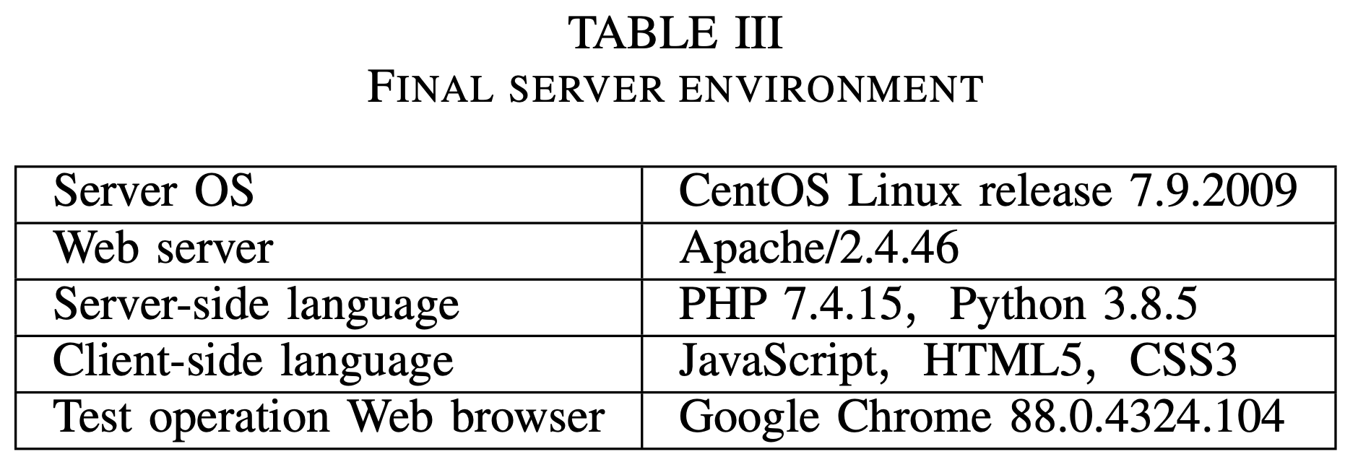
Information Technology Required to Develop the Web Application
Blockly and Server Maintenance
Apache HTTP Server (Apache) and Nginx have a high usage rate in terms of the web servers' usage rate. Apache has the following five characteristics.
・It is open-source software (OSS).
・It is extensive to several modules.
・Security measures have constant updates.
・The operation is agile and stable.
To maintain the server, CentOS 7 and its software should be updated to the latest version. The final server environment is shown in Table 3.

Slide 10
Architecture of the System Proposed in this Study
Specifications to Build-up the Blocks
The implementations of projects such as DX and Society 5.0 require a vast application of data analysis. Additionally, visual programming is mainly used for research related to the field of education. However, there exist few examples of research in other fields.
Considering these drawbacks, we combined visual programming and data analysis using Blockly as a visual programming platform.
・Loading data is not implemented.
・There is not a block for data analysis.
・There is not libraries to perform data analysis.

Slide 11
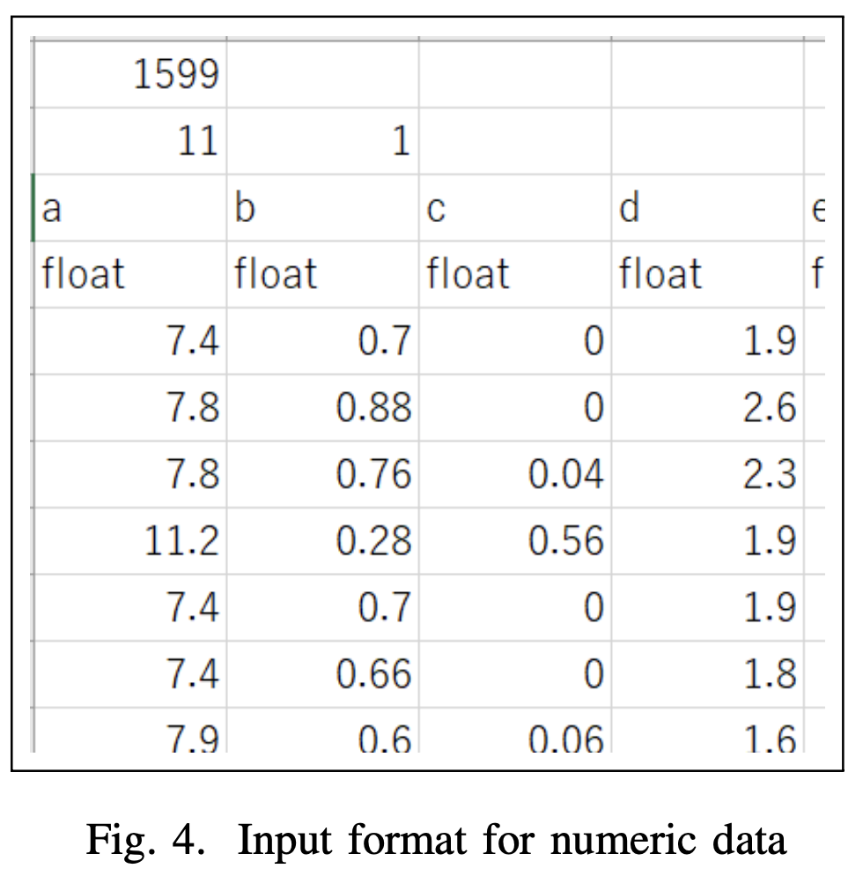
Architecture of the System Proposed in this Study
Specifications to Build-up the Blocks
Figure 4 shows the actual data displayed using Excel.
The first row of cells contains the number of data, the second row of cells contains the number of explanatory variables or inputs.
The second row of cells contains the number of objective variables or outputs, the third row of cells contains the name of the label, the fourth row of cells contains the name of the data, and so on.
The third row contains the label name, the fourth row the data type, and the fifth and subsequent rows contain the input data corresponding to the first through fourth rows.
The file used for data analysis can be created using Excel or any text editor.

Slide 12
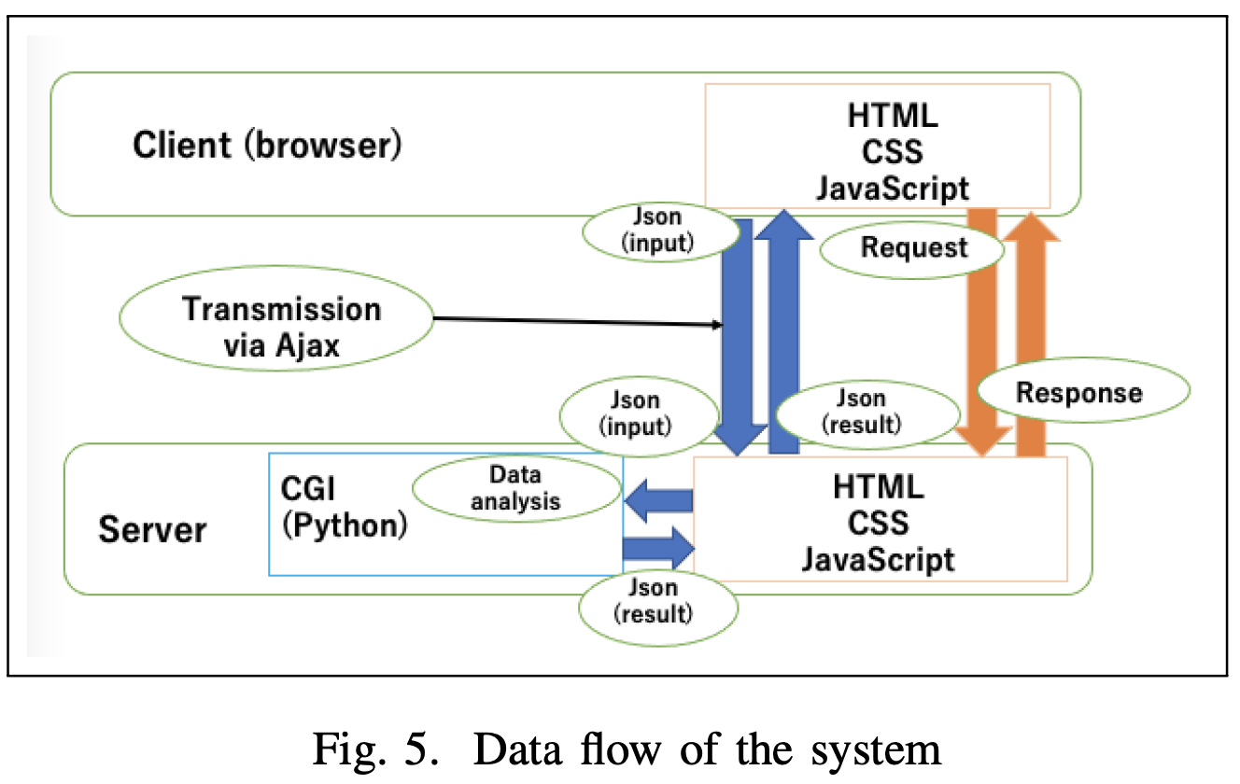
Architecture of the System Proposed in this Study
Specifications to Build-up the Blocks
This study created an original block to analyze data continuously on Blockly using multiple analysis methods. First, in order to analyze data on Blockly, we need to load data from somewhere. There are three ways to load data:
・The client inputs data directly using
an input device.
・Files containing data possessed by
the client are loaded.
・Reading data on the network.
The system’s data flow is shown in Figure 5.

Slide 13
Architecture of the System Proposed in this Study
Specifications to Build-up the Blocks
Next, we considered the parameters that are necessary when treating data as data in data analysis.
・Amount of data: if data is obtained on a time axis, then the data in time is the number of data in the data. In other words, the number of data is the number of data on the axis when the axis classifies something.
・Explanatory and objective variables or amount of inputs and outputs: an explanatory variable is a variable that is the cause of something. The objective variable is the variable that is the result of the cause of the explanatory variable.
・Label: a label name is a name that indicates the content of the data. For example, if the data is temperature data, the label name is temperature.
・Data type: insert data type according to the programming language, such as int for integers or string for characters.

Slide 14
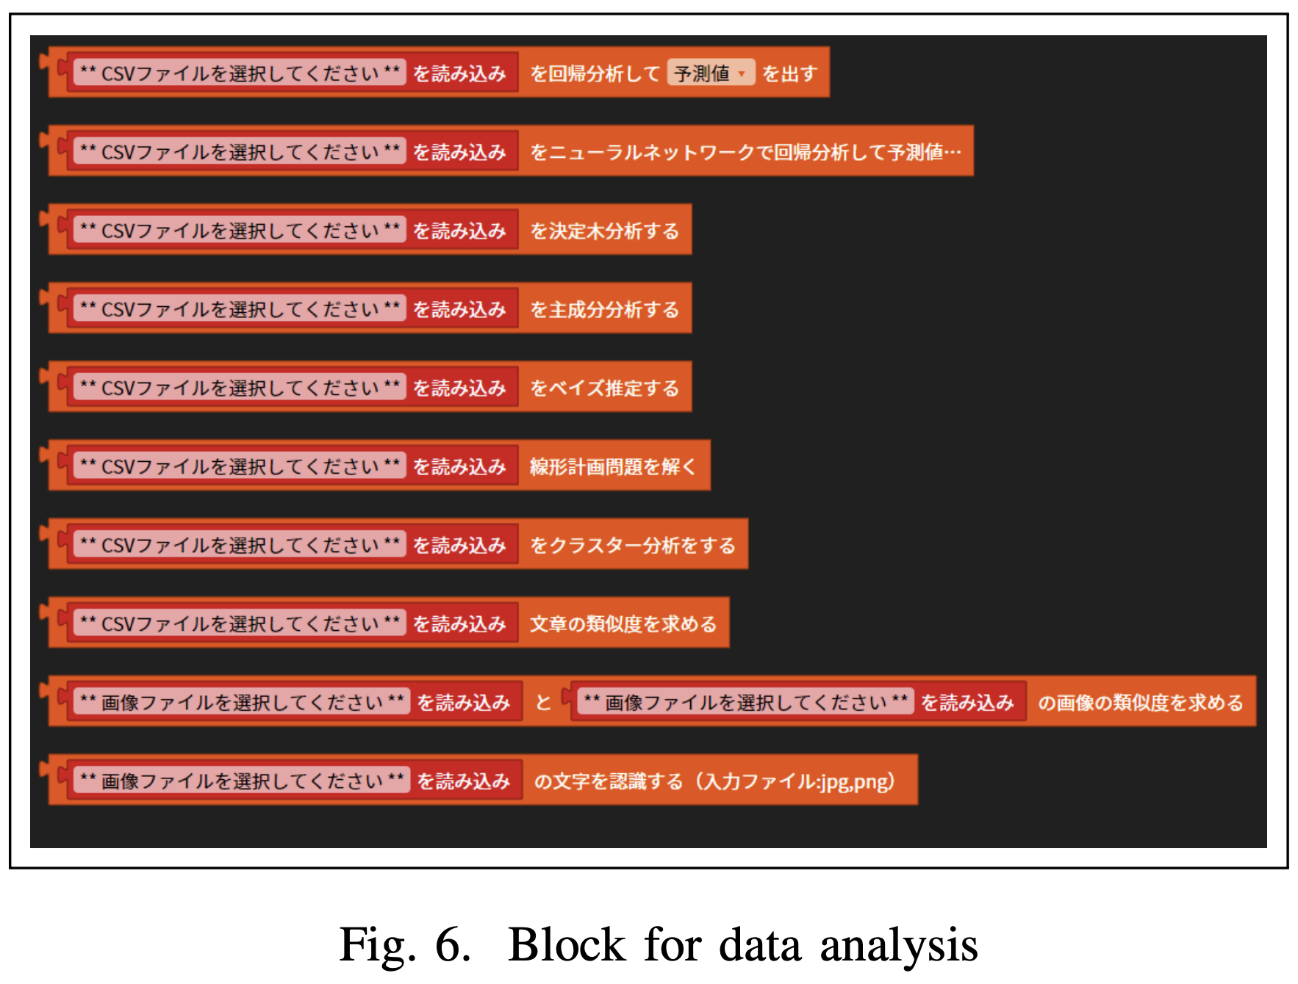
Architecture of the System Proposed in this Study
Built-in scripting languages such as Python
Only a limited number of programming languages and their libraries can be used on the client-side, so server-side processing is done through blocks.
To do this, Ajax can be incorporated into the block program to send a request to execute a CGI data analysis program that exists in the web server.
Then, the program is executed on the server and the results are returned to the client.

Slide 15
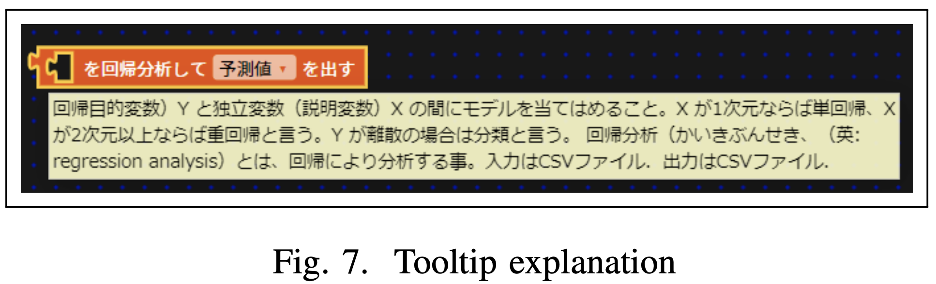
Architecture of the System Proposed in this Study
Built-in scripting languages such as Python
In this study, CGI is written in Python, an interpreted high- level, general-purpose programming language. Python comes with several functions as standard libraries, such as the json library for using json and the math library for particular calculations. Many functions are provided in advance.
Writing in Python makes it possible to use a wide variety of third-party libraries, including libraries for mathematical processing, scraping, and multimedia. Therefore, many libraries can be used for data analysis. The tooltips explain each block’s role is shown by Figure 7.

Slide 16
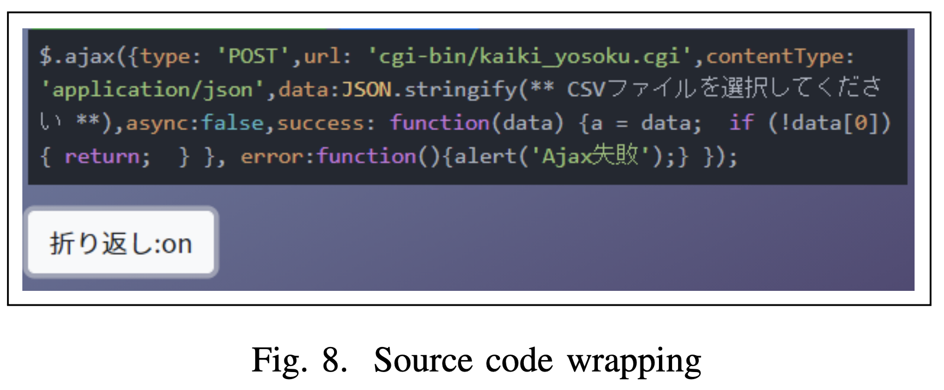
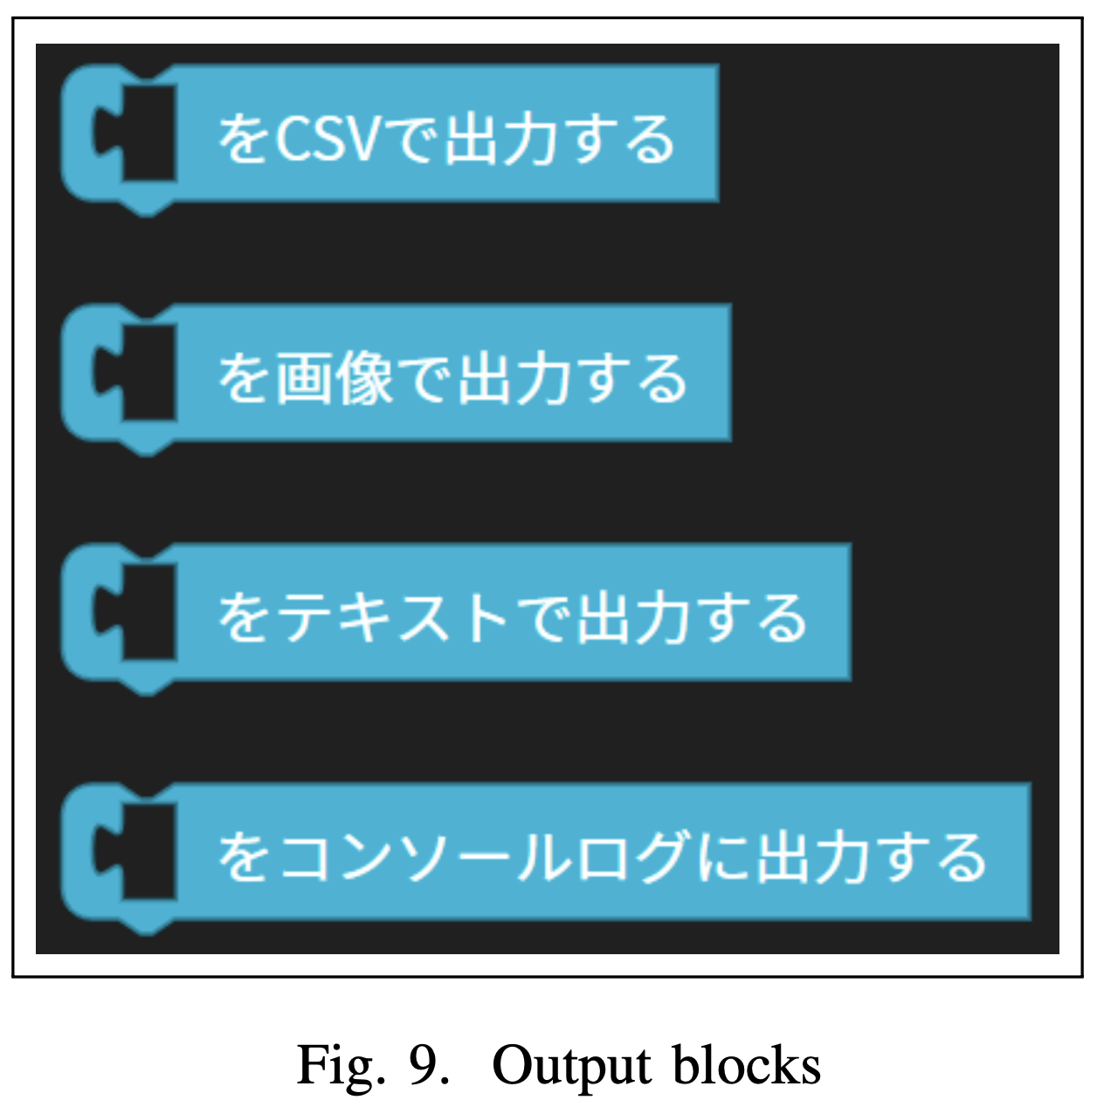
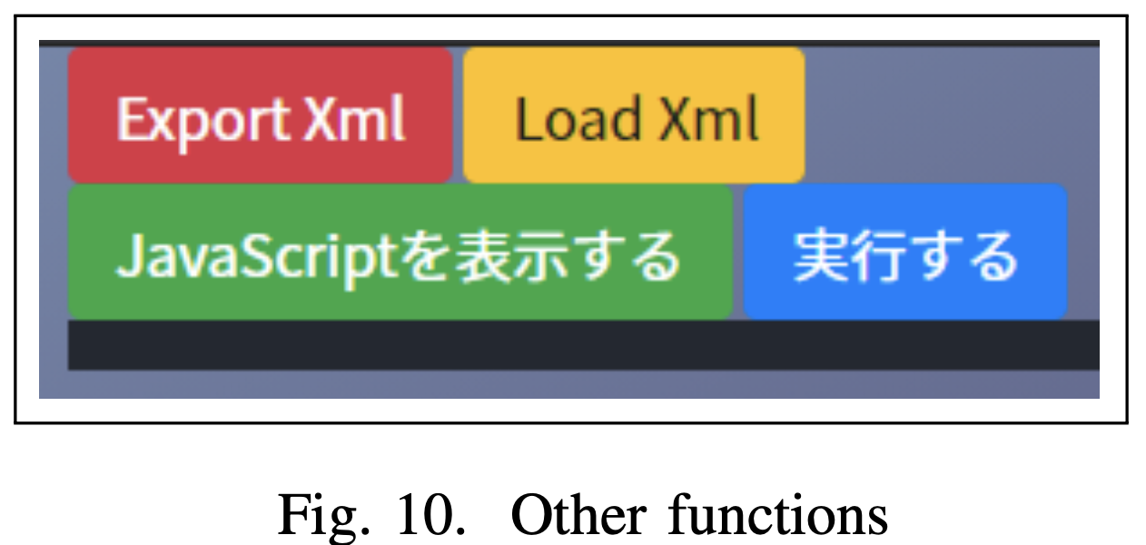
Architecture of the System Proposed in this Study
Specifications to Build-up the Blocks
Figure 8 shows an excerpt of a source code. Blocks that cannot be connected to others are rejected when one tries to connect them. The output blocks are shown in Figure 9, wherefrom top to bottom, downloads of different files such as csv files, an image file, text file, respectively, are possibly displayed in the console log. Buttons for other functions such as saving block can be visualized in Figure 10.

Slide 17
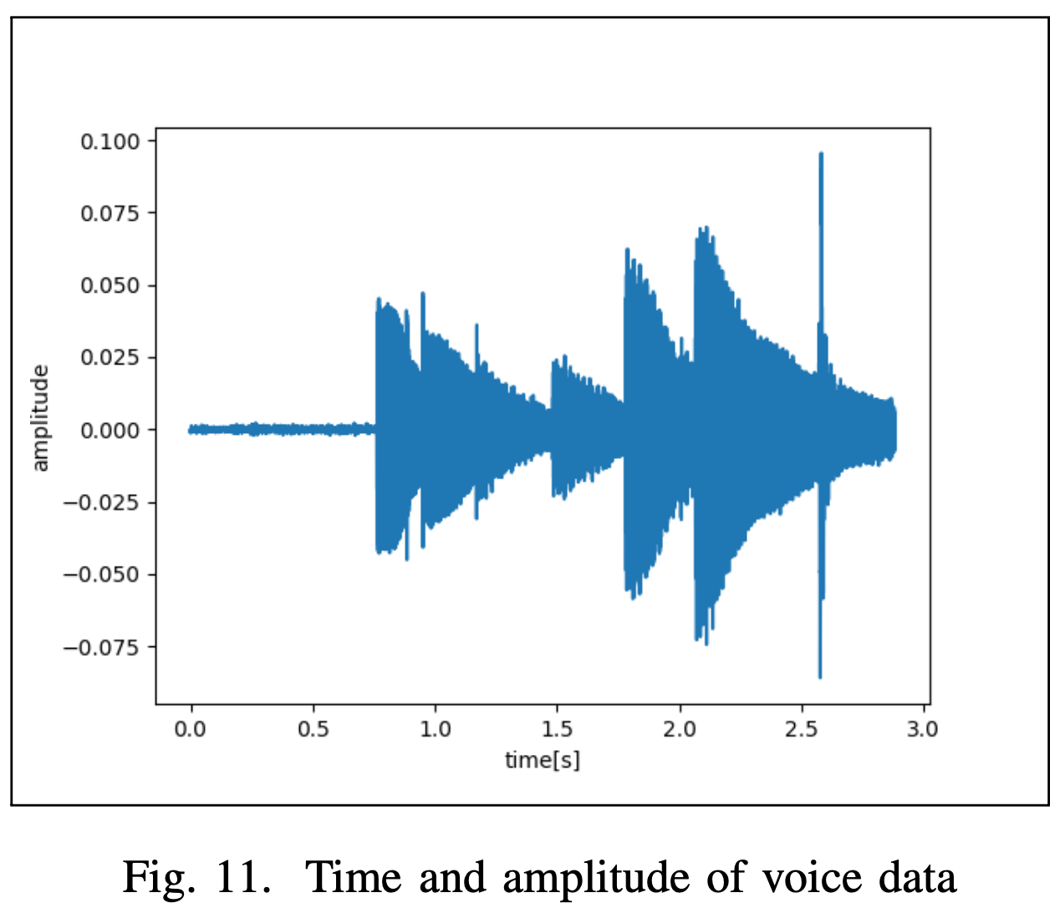
Experimental Results and Discussion
Experimental Results
The experiment's purpose is to evaluate whether the proposed system can be used for easy data analysis. We also evaluate the other usability and accessibility of the system. First, we created our account at the login site and logged in. Next, they selected a data analysis tool from the intermediate site and connected it to the DABlockly web application.
Here, we selected a block that displays frequency components as the data analysis block for voice data. The audio data used in the experiment is shown in Figure 11.

Slide 18
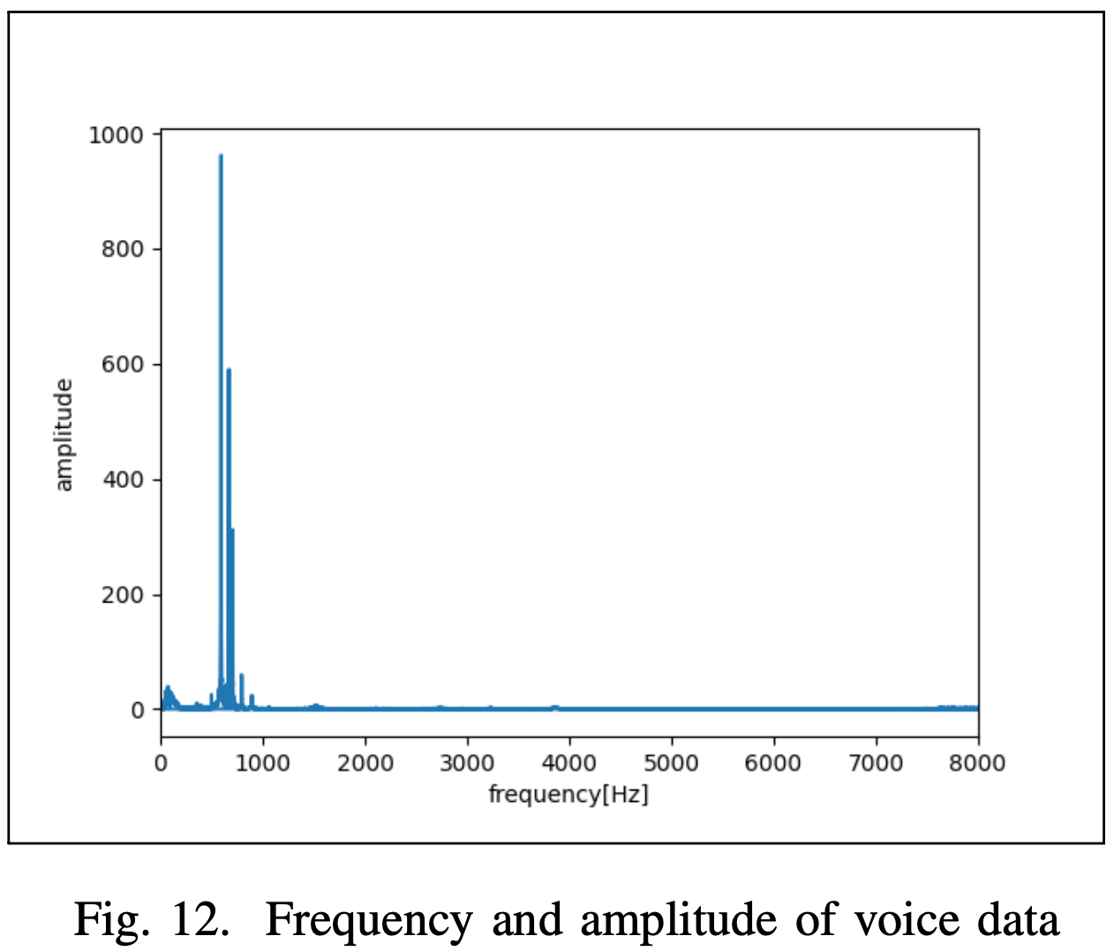
Experimental Results and Discussion
Experimental Results
They selected one data analysis block from audio data, numerical data, text data, and image data. The data analysis blocks were selected and used on the actual data. Figure 12 shows the result of displaying the frequency components. Observe that the sound is concentrated roughly in the range of 500Hz to 900Hz.
Discussion
As for usability, the first problem is that it takes a long time to load a file when the data size is large. Image data and audio data are encoded in base 64 and displayed as characters on the Blockly. We think this is caused by the fact that the data is not stored on the server. The reason for this is that the client-side processing is heavily loaded.

Slide 19
Conclusions
In this study, we developed a data analysis system using a visual programming language. We developed a data analysis system using a visual programming language.
We used Ajax communication to call the necessary libraries and CGI programs from the server side. In Blockly, data analysis results are displayed on the visual program by calling the necessary libraries and the CGI program that executes them from the server side using Ajax communication.
Besides, unifying the data format made it possible to stack blocks in some blocks and perform other data analyses using the output results from the previous block's data analysis in a single run. Also, experiments have shown that it is possible to analyze numerical data, text data, image data, and voice data.

