Slide 1

Coping Support and Stress Detection
Using Ambient Computing
6th International Conference on Business Management of Technology (BMOT 2021)
July 11- 16, 2021
Antonio Oliveira Nzinga Rene¹ , Koji Okuhara¹,
Junko Shibata² and Takeshi Matsui³
¹ Toyama Prefectural University
² Kobe Gakuin University
³ Gunma University
Sponsor
International Institute of Applied Informatics

Slide 2
Introduction
Background of this study
This study employs sensors to create a lifelog that records human biometric and behavioral information as digital data. Then, from the log, we can identify human behavior. Identifying the behavior makes it possible to adopt stress countermeasures. This paper proposes a method to support individuals from mental and physical burdens by analyzing stress countermeasures and providing assistive displays through smart glasses.
Also, since the display from the sensor to the smart glasses is automatically processed, no specific operation is required on the human side. Therefore, the system functions as ambient computing. We aim to develop an ambient computing system that can determine the coping contents and display them on the smart glasses based on the user's behavior identification without any operation.

Slide 3
Introduction
Purpose of this study
Ambient computing represents a system in which machines automatically recognize human behavior and run systems regardless of human intervention. A ubiquitous society is a concept that represents an environment where users can access information without being aware of computers. On the other hand, the ambient society is a further evolution from the ubiquitous society. It represents an environment where it is natural to be connected to the Internet through computers regardless of time and place.
Although the concept of IoT has become popular globally, some of the devices still contain human instructions, and the widespread use of ambient computing may support people in their daily lives and improve their work efficiency. Using ambient computing technologies, one can predict and support human behavior. It can reduce the burden on humans, improving efficiency, and even provide mental and physical support.

Slide 4
Agenda
This paper is structured as follows. After this introduction,
Section 2 outlines the study and describes its purpose.
In Section 3, the study describes aspects related to previous research regarding LifeLog data from collection to identifying behavior's evolution, including ambient computing and measure of stress using sensors.
Section 4 starts with the history and practical applications of intelligent glasses as wearable terminals for behavioral assistance. Them describes the proposed technique outlining necessary aspects of the experiment and its discussion.
Section 5 concludes the paper.

Slide 5

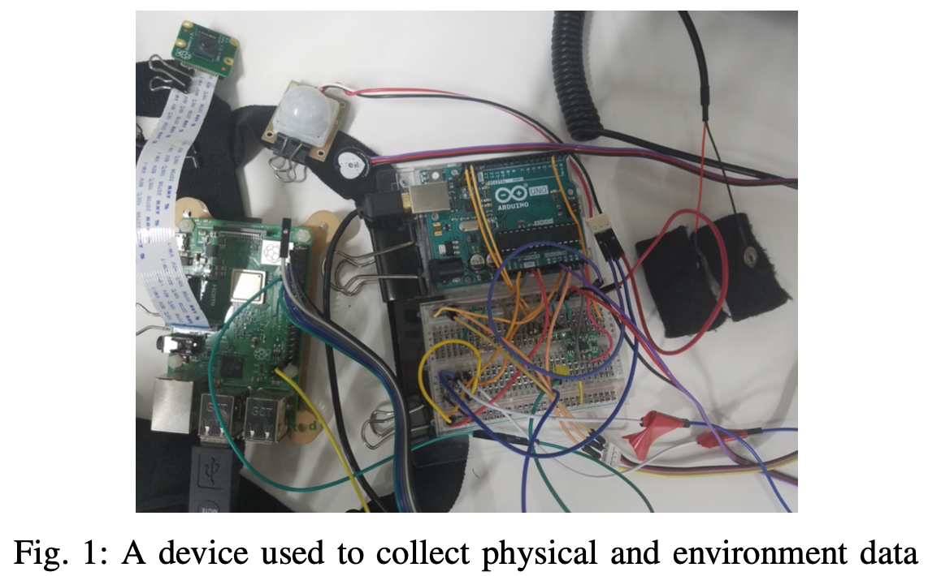
Behavioral Awareness using Biological and Environmental Lifelogs
Lifelog Collection Using Biometric and Environmental Sensors
The sensors are measured using Arduino UNO and Raspberry Pi 3 Model B. The sensors to analyze temperature, humidity, barometric pressure, illumination, motion, body temperature, heart rate, and galvanic skin response sensors are connected to Arduino UNO and collecting eight categories of data.
The Raspberry is connected to the following sensors: acceleration (3 axes), angular velocity (3 axes), magnetic compass (3 axes), camera, microphone, and GPS (latitude and longitude), and collects 13 types of data (see Figure 1).

Slide 6

Behavioral Awareness using Biological and Environmental Lifelogs
Identification of Behavior by Cluster Analysis
The microphone text obtains the labels for each cluster, where the label "latest'' represents the latest data from the sensor. The acquisition of data from the microphone is possible through Arduino UNO.
We set up a hotword to prevent the microphone from generating unwanted labels due to ambient noise. For such purpose, we first input the hotword, and once correctly converted to text, input the label. When the label is also converted to text, we are ready to get the hotword again.
Once both are successfully converted to text, a lamp connected to the Raspberry lights up so that the user can see the status without looking at the program execution screen. By labeling with the microphone, the latest data, i.e., the current behavior, can be identified, including the cluster and label to which it belongs.

Slide 7
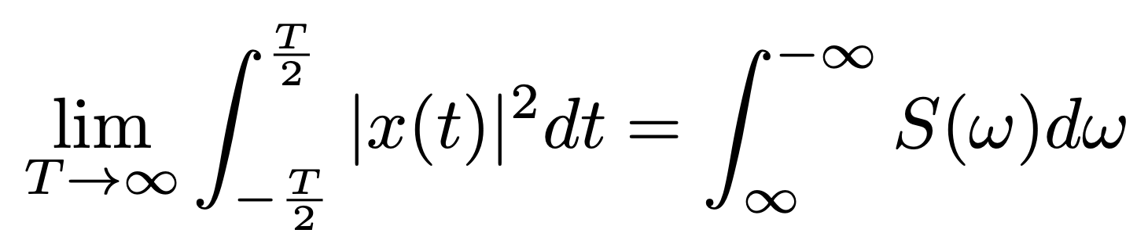
Behavioral Awareness using Biological and Environmental Lifelogs
Measuring Stress through Sensors
In this study, "stress" refers to the degree of tension and balance between the sympathetic and parasympathetic nervous systems and is referred to as "stressed" when the sympathetic nervous system is tense and "relaxed" when the parasympathetic nervous system is tense.
High frequency (HF) and low frequency (LF) are used to estimate the balance of the autonomic nervous system and are considered indicators of stress values among biometric data. The study uses either Fast Fourier Transform (FFT) or autoregressive (AR) in the analysis.

Slide 8
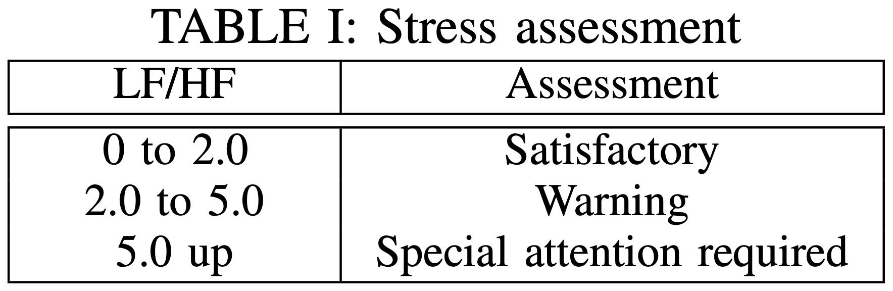
Behavioral Awareness using Biological and Environmental Lifelogs
Measuring Stress through Sensors
The left side of FFT is the heart rate signal power per unit of time T while the right side represents the ratio of the contribution of each frequency to the total power, S. The magnitude of HF and LF components can be compared from the PSD of each heartbeat. The LF region is between 0.05 Hz and 0.15 Hz, and the HF region is between 0.15 Hz and 0.40 Hz. The integrated values in the range, i.e., the sum of the intensities are defined as LF and HF.
It is difficult to standardize the evaluation method of LF/HF due to individual differences and environment, but the criterion presented in Table 1, also applied to the current study, is often used in stress research. It is said to be a relaxed state.

Slide 9
Ambient Intelligence and Modern Society
Overview of Ambient Computing
Ambient refers not only to the relationship between the user and the computer but extensive to the user, home appliances used by the user, the place, and the whole environment. One of the research directions on ambient computing is to analyze the movements of users (residents) in detail, predict their behavior patterns, and adjust the startup of electrical appliances to reduce power consumption without user intervention.
The concept of ambient computing is more people-centered in the concept of information and communication. Within the vision of the ambient society, the technology represents many cases involving people directly, for instance, at a workplace or even at homes. Thus, several applications using the technology are in housing and office space-related research. The technology has been attracting attention as a method of providing services to users and solving energy problems.

Slide 10
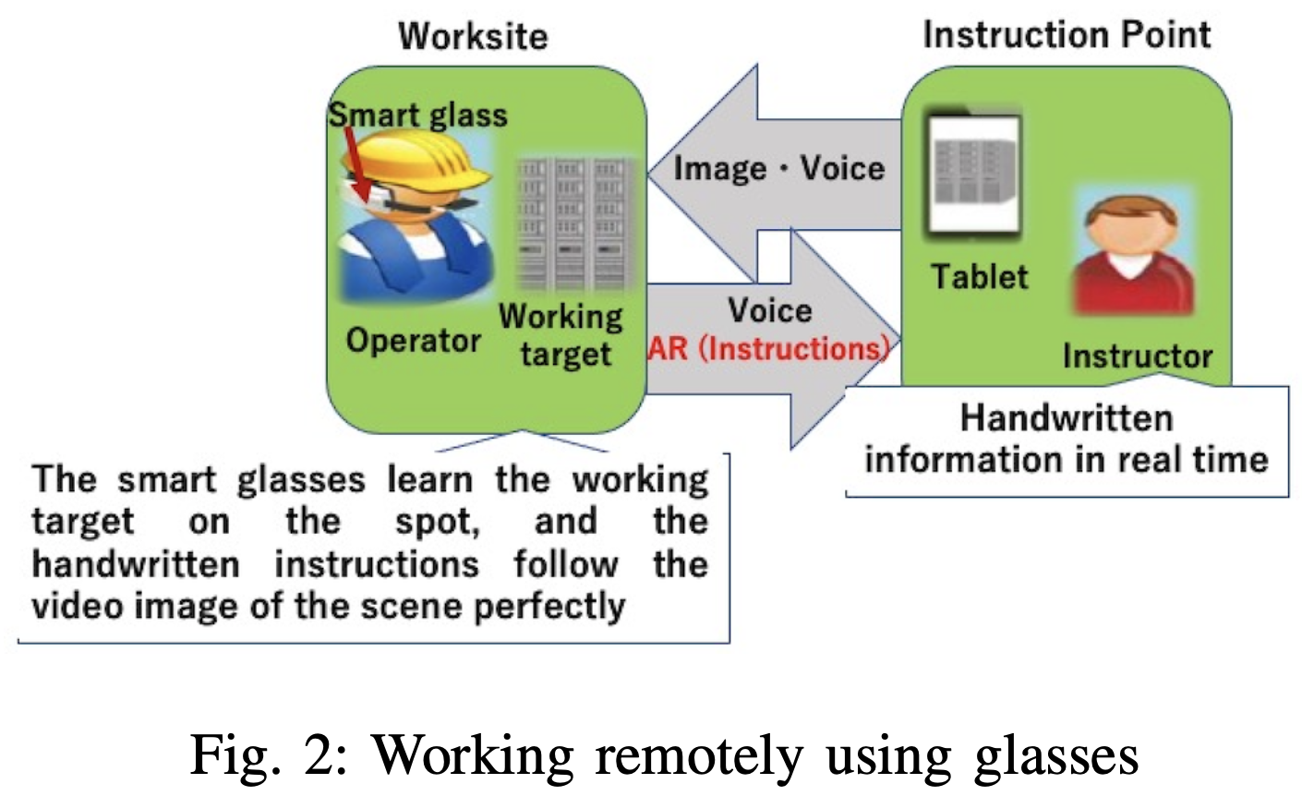
Ambient Intelligence and Modern Society
Practicality of Smart Glasses and their Role as Assistive Devices
Although glass is a different device from AR glasses, installing an AR application is possible through Unity and ARCore. Typically, the MOVERIO series and other smart glasses do not have an application installation service such as Google Store, but there is an application for sale specifically for glasses, allowing users to enjoy advanced video content.
The number of examples of smart glasses usage increases daily, covering a wide range of fields. For the sake of preference, there are movie viewing and sightseeing guides not restricted by location, and in industry, there is hands-free and efficient work while looking at manuals. As an illustration of the application of our system in the industry, one can give instructions through the glass when the operator and the support staff are far away from each other at a specific work site (refer to Figure 2).

Slide 11
Ambient Intelligence and Modern Society
Stress and Coping Techniques
This study focuses on physical and mental stress caused by long hours of computer operation and desk work and the same system. Since the purpose of the study is to provide an appropriate for coping in each activity, problem-focused coping is implemented. Since a computer cannot deal with human relationships, we do not focus on stress from face-to-face connections but only alert the participants. The study focuses on stress related to computer operation and desk work. It includes resting eyes, improving blood flow to the eyes, hydration, and stable sleeping.
Working on a computer for a prolonged period can lead to eye strain and insomnia. Taking frequent breaks or simply closing eyes and doing nothing can be effective. Additionally, eating a hot meal, drinking water, and getting enough sleep are best practices to prevent stress.

Slide 12
Proposed Method
Storing Data on Server
As for the general flow of data transmission, the Arduino UNO collects 17 types of biological and environmental sensor data (excluding the microphone and camera) and sends them to the Raspberry via serial communication.
To this data, we added GPS data (latitude and longitude) acquired by the Raspberry, data image from the camera is converted to text, and LF/HF values calculated using the heart rate data and sent these four categories of data to a server located in a laboratory at Toyama Prefectural University via a socket communication.
Audio data from the microphone is acquired by a separate program on the Raspberry and sent to the same server. Therefore, two types of data are sent to the server, namely biometric and environmental sensor data and voice text data.

Slide 13
Proposed Method
Storing Data on Server
The sensor data is sent to the server in consideration of the HTML update program's processing time. However, it takes more than five minutes to accumulate 1024 data acquired three times per second. Therefore, after the program is started, the heart rate data is 1024, and the LF/HF value is calculated and sent.
The heart rate data is not retrieved from the beginning, but the oldest data is 100 deleted, and the new heart rate data is 100 retrieved. In other words, the data is sent every 30 seconds, and although the data is for 5 minutes, it is treated as the latest 30 seconds. Besides, the voice data from the microphone is acquired and transmitted at any time by the user.
The Raspberry used in this project applies Wi-Fi for socket communication. Consequently, when used indoors, one can connect to the wireless network within the location, while outside, it cannot work. We use a smartphone's desiring function and connect to the Wi-Fi using the smartphone as the parent device to solve this problem.

Slide 14
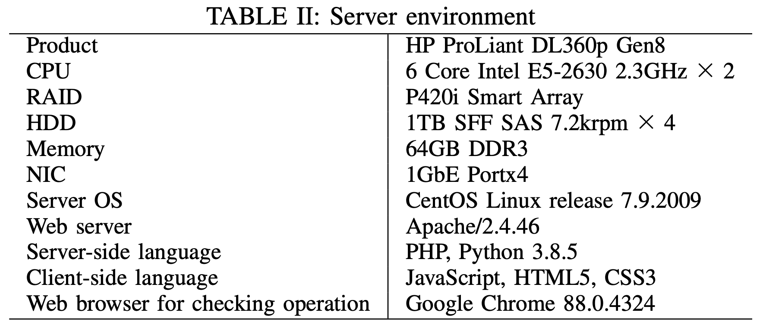
Proposed Method
Storing Data on Server
Table 2 shows the server environment used in the study. The system's primary language is Python 3, while the server works with Python and displays HTML in a browser.
The executable program combines sensor data and voice data when the data was acquired and converts it into a lifelog csv file. Since we do not know when the voice data is acquired, we compare the time of the two data and combine the data closest at the same time. Since sensor data is sent every 30 seconds, if the difference between the acquisition time of voice data and sensor data is set to 15 seconds, the voice data can be combined with the sensor data with the closest acquisition time.

Slide 15
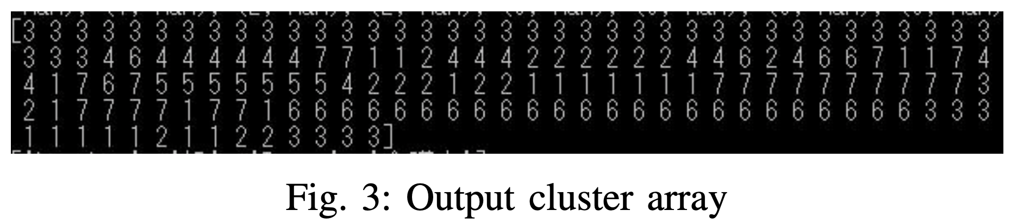
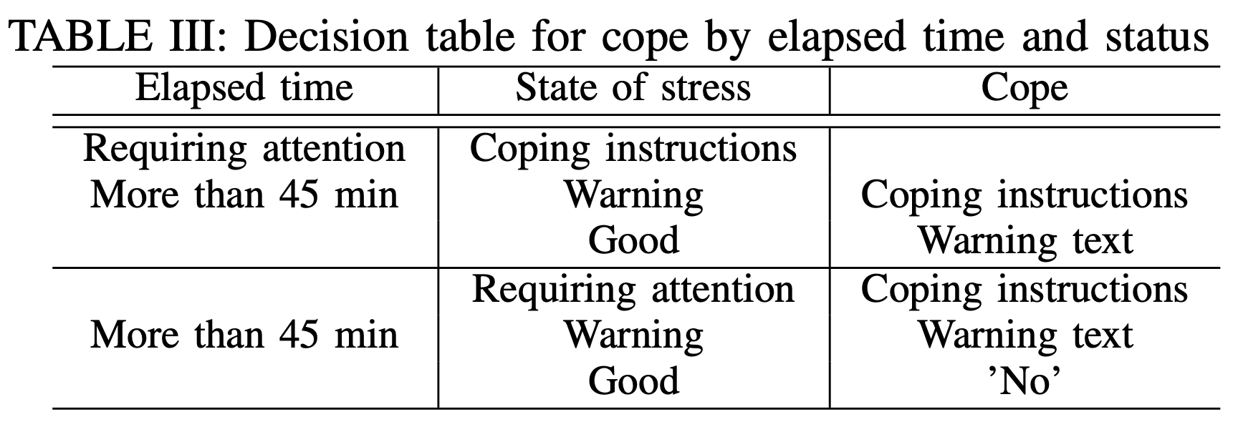
Proposed Method
Experimental Results and Discussion
We describe how to set up the nine coping items based on life logs, cluster analysis, and stress values. We use a time-series cluster number array, which is the result of cluster analysis. This array is numbered for each cluster, and the cluster numbers of each lifelog data are arranged in chronological order (see Figure 3).
First, the decision to perform coping is based on the elapsed time of the behavior and the state. If the status is "needed attention," coping is performed, but if the elapsed time exceeds the standard, coping is performed even if the status is "cautionary. If it is “good", a simple warning message is displayed to call attention to it (see Table 3.

Slide 16
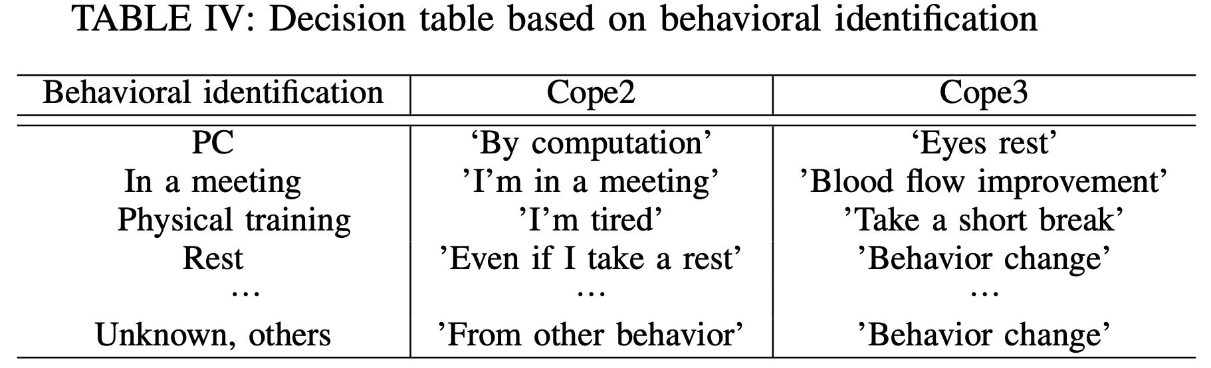
Proposed Method
Experimental Results and Discussion
Table 4 shows the Cope2 and Cope3 for each action identification when coping is implemented. Cope2 is the predicted action based on the schedule, and Cope3 is the possible coping for that situation. Coping is not only about presenting problems.
For example, it is impossible to take a break during a meeting because some stress measures may not work. Therefore, Cope3 should be set separately for each situation, but if the situation is possible, it should be a "behavioral change'' that can change the mood.

Slide 17
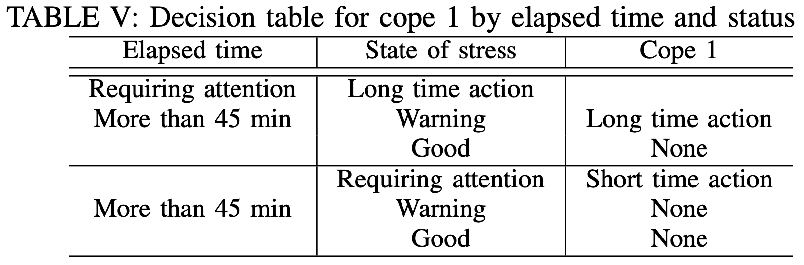
Proposed Method
Experimental Results and Discussion
If the time of action does not exceed the criterion, no copying is performed if the state is "normal," and the command is displayed as "No." If it is "Caution," a warning message is displayed. Since there are multiple factors in the coping decision, the coping sentences (Cope) to be displayed are divided into three categories: elapsed time (Cope1), identification (Cope2), and command (Cope3). Cope1 in Table 5 is the elapsed time part, while Cope1 does not exist in the case of no coping or warning text because the text is fixed.
When the status is "needed attention" or the status is "attention" due to an action performed for more than 45 minutes for the action, the action identification determines the coping content and the elapsed time of the action.

Slide 18
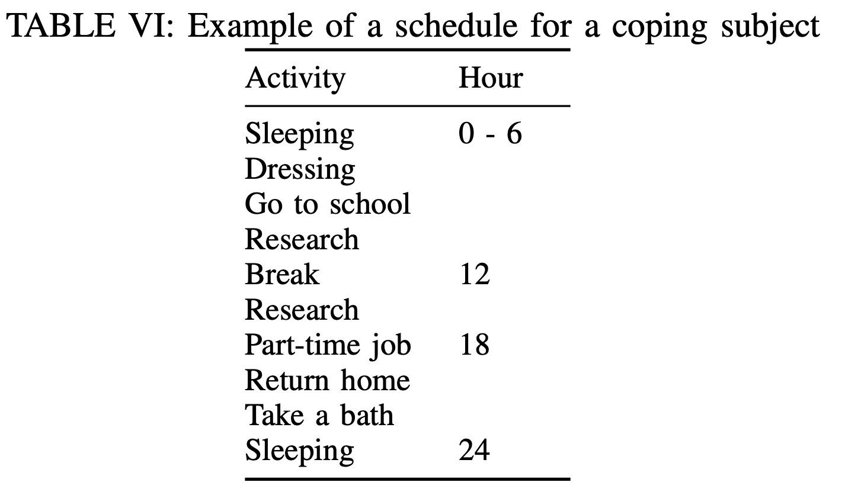
Proposed Method
Experimental Results and Discussion
Coping should be appropriate to the situation at the time. Therefore, it is necessary to predict the behavior of the day and the stressful situation to some extent and set appropriate coping. In the present study, since the target was behavior in the laboratory and behavior outside the laboratory, the settings were based on "a graduate student doing programming for research during the day. Table 6 in the microphone input, we mainly input each action in this schedule, but also input the actions during "free time" and when we took other actions.

Slide 19
Conclusions
In this research, we aimed to reduce mental and physical burdens caused by prolonged and stressful activities such as desk work by identifying behaviors from biometric and environmental sensors, detecting which behaviors are more stressful for the user, and presenting optimal coping from the identification using ambient computing.
To achieve this goal, we used biometric and environmental data. For this purpose, we used a wearable sensor device that acquires biological and environmental data to generate heart rate variability time series data using a heart rate sensor and calculated LF/HF values, which are stress indicators.
We implemented an ambient computing system that automatically executes a coping process for each action without user intervention.

