Slide 1
Menu Creation Support System
Considering User eXperience
Based on Multiobjective Optimization
Yurie Okuhara
2010022122@campus.ouj.ac.jp
Informatics The Open University of Japan

Slide 2
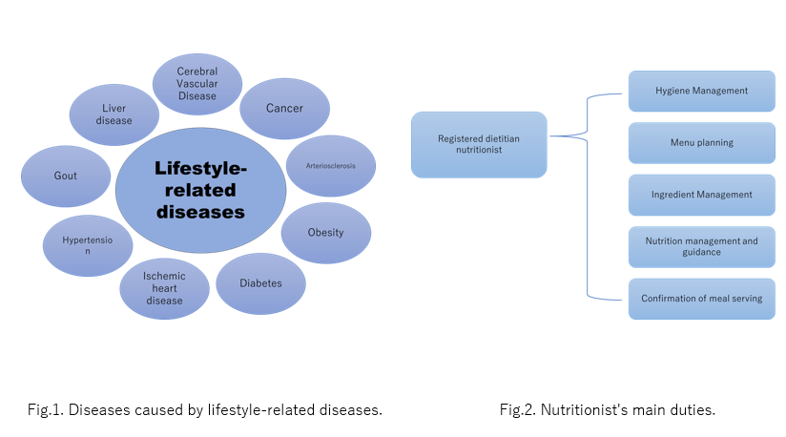
本研究の背景
In recent years, the number of people suffering from lifestyle-related diseases has been increasing. Lifestyle-related diseases are “a general term for diseases caused by lifestyle habits such as eating habits, exercise habits, rest, smoking, drinking, and stress,” and are deeply related to serious diseases.

Slide 3
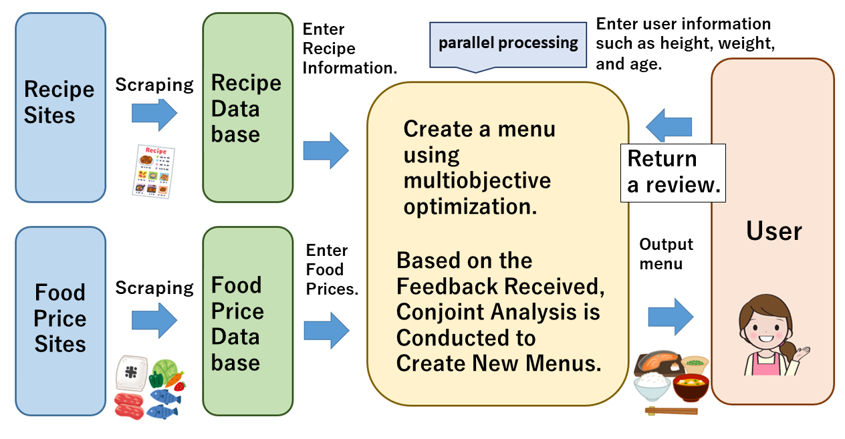
本研究の目的
We propose a computer-based system that automatically creates menus with the nutrients and calories that not only healthy people but also people with lifestyle-related diseases or allergies that require restricted diets should consume. The system estimates and assigns a rating from the viewpoint of user eXperience by having users provide feedback on their ratings.

Slide 4
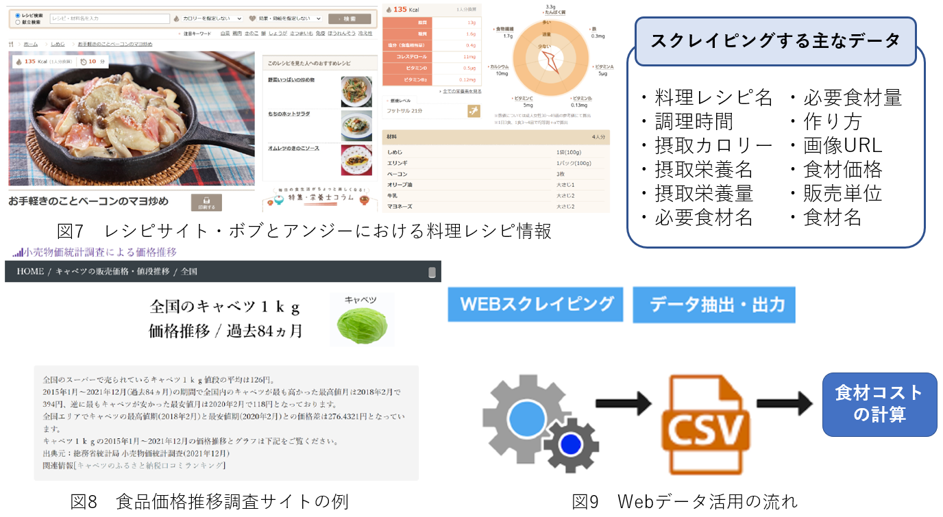
Web上のレシピデータを活用
Scraping of data from the recipe site “Bob and Angie” for dishes included in the main dish and side dish categories and recipe data (required ingredients, nutritional intake, calories, etc.) from a keyword search on breakfast, and scraping of data on various foods and their prices from the site “Price Survey by Retail Price Survey,” which investigates food price trends. Scraping of food price data from the “Retail Price Survey,” a website that researches food price trends. Next, the cost of ingredients is calculated by comparing the ingredients in the food recipe data with the ingredients in the ingredient price data.Translated with DeepL.com (free version)

Slide 5
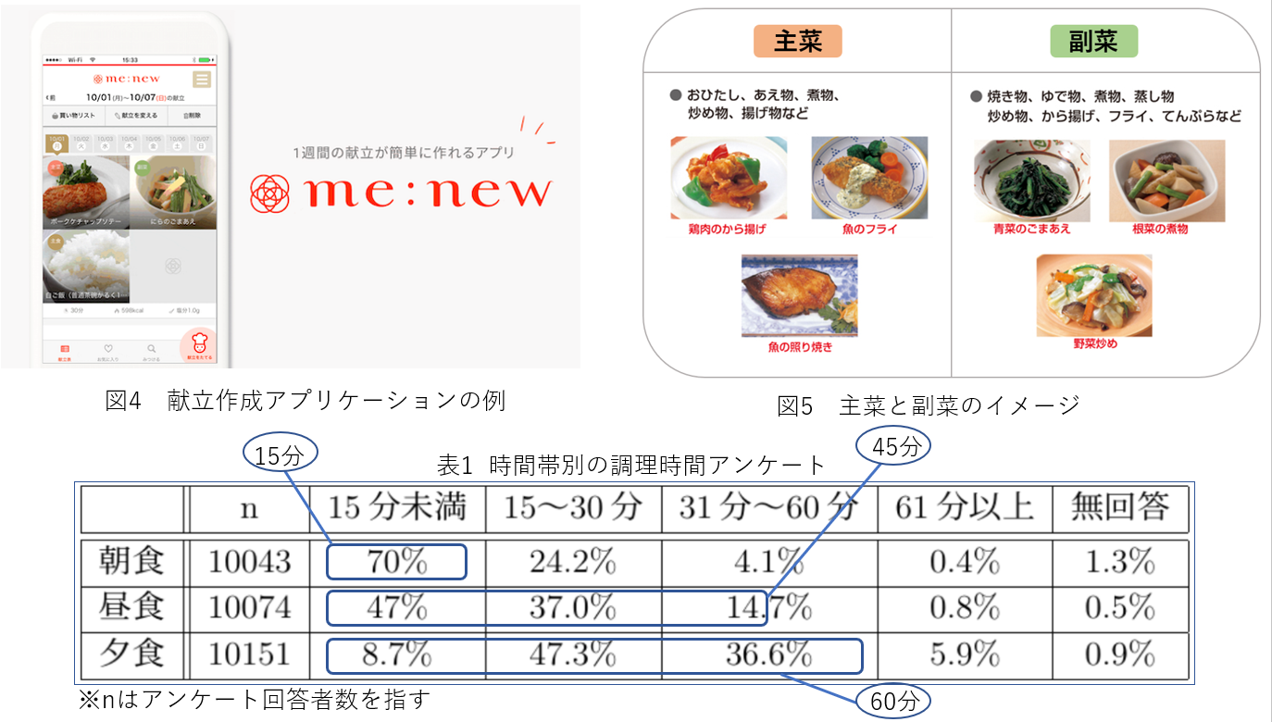
自動献立作成支援システムの概要
An automatic menu creation support system is a system that can automatically generate a menu. The main and side dishes are prepared as components of a menu. In addition, a cooking time questionnaire for each time period is used as a reference for numerical experiments.

Slide 6
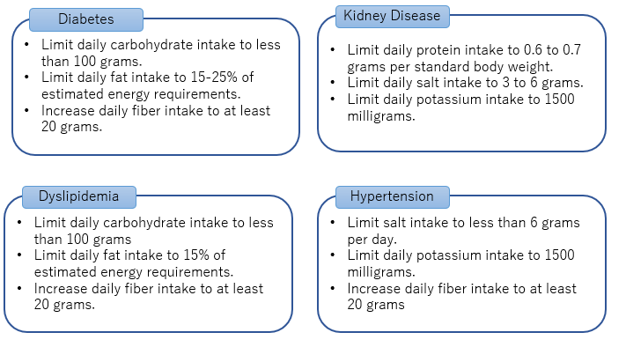
健康のための制限食の考慮
Restricted diets must be considered for some individuals. Restricted diets are diets that limit calories and nutrient intake according to an individual's health and disease status. A restricted diet that is appropriate for the type of disease can improve the symptoms of the disease. It can also prevent lifestyle-related diseases even in the absence of disease.

Slide 7
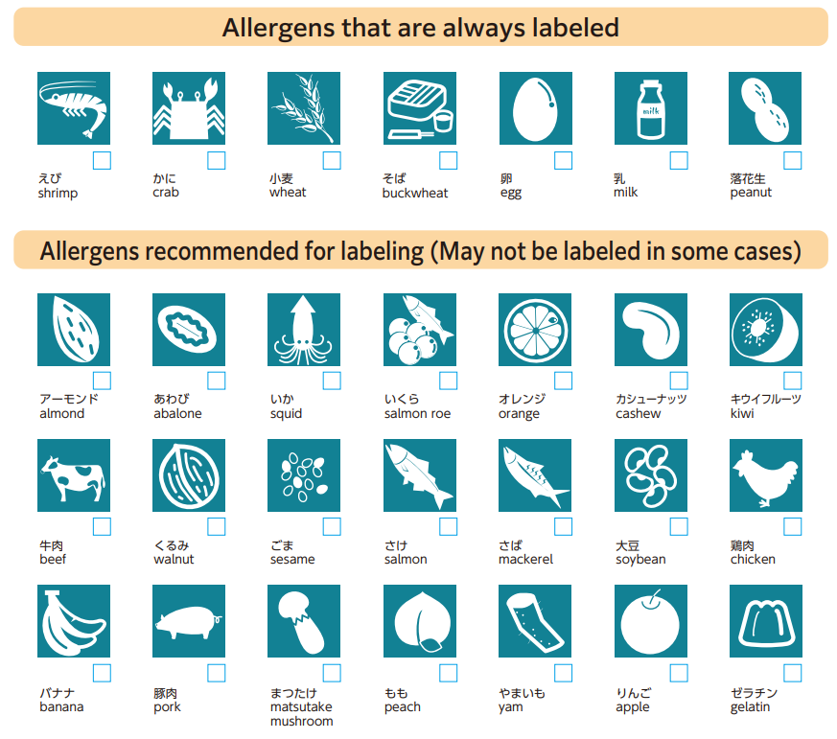
健康のための制限食の考慮
Allergy items cover 28 items designated as “specified raw materials, etc.” for which cases of serious health hazards such as hypotension, dyspnea, or disturbance of consciousness have been observed at a certain frequency in the past.

Slide 8
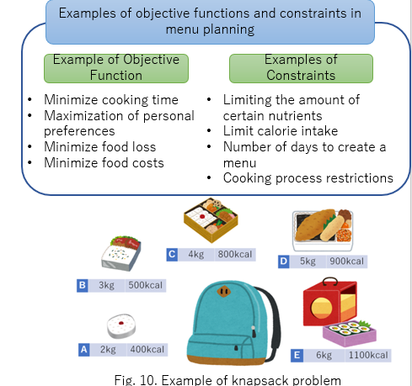
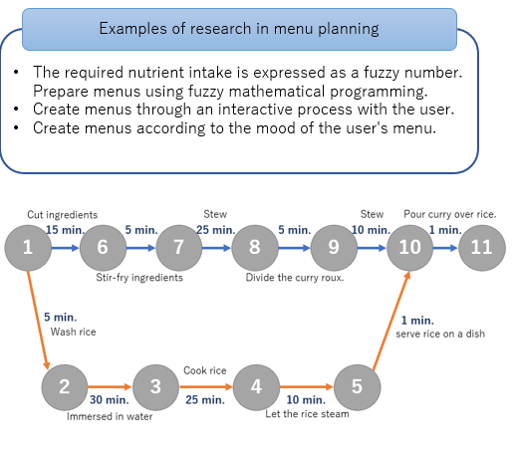
多目的最適化による自動献立作成
A menu planning system can be viewed as a combinatorial optimization problem that searches for a combinatorial solution with parameters that maximize or minimize the objective function within predefined constraints. Constraints in menu planning include how many days of meals to prepare, how many calories to limit, and so on. Objective functions include minimizing cooking time and maximizing personal preferences.

Slide 9
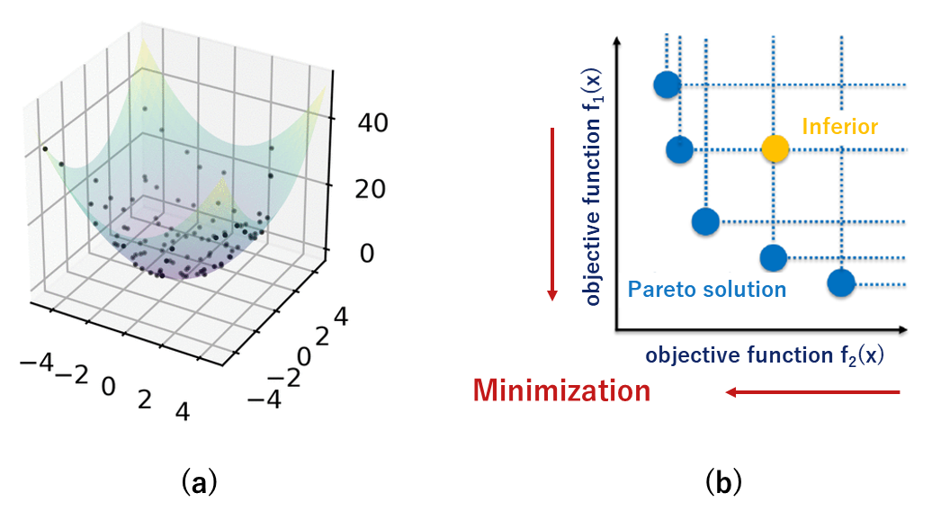
多目的最適化とパレート最適解
Multi-objective optimization is a method of maximizing or minimizing multiple objective functions under certain constraints. Since it cannot be said that there exists an optimal solution that maximizes or minimizes all objective functions, it is necessary to introduce the concept of Pareto optimization.

Slide 10
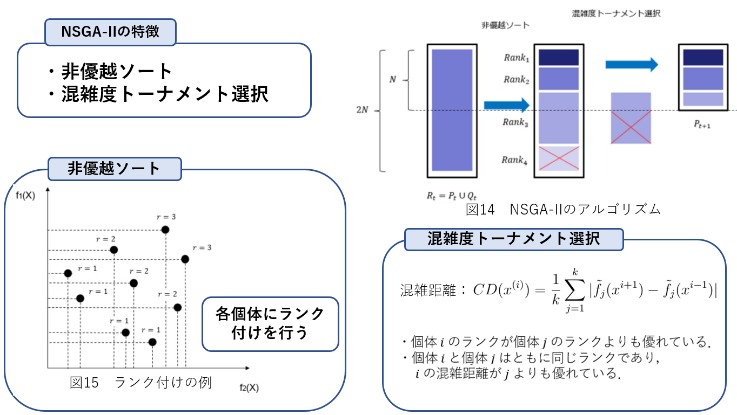
遺伝的アルゴリズムによる多目的最適化
NSGA-II is used to solve multi-objective optimization problems. It is an extension of the genetic algorithm to multi-objective optimization problems, with features such as non-dominated sorting and congestion tournament selection.

Slide 11
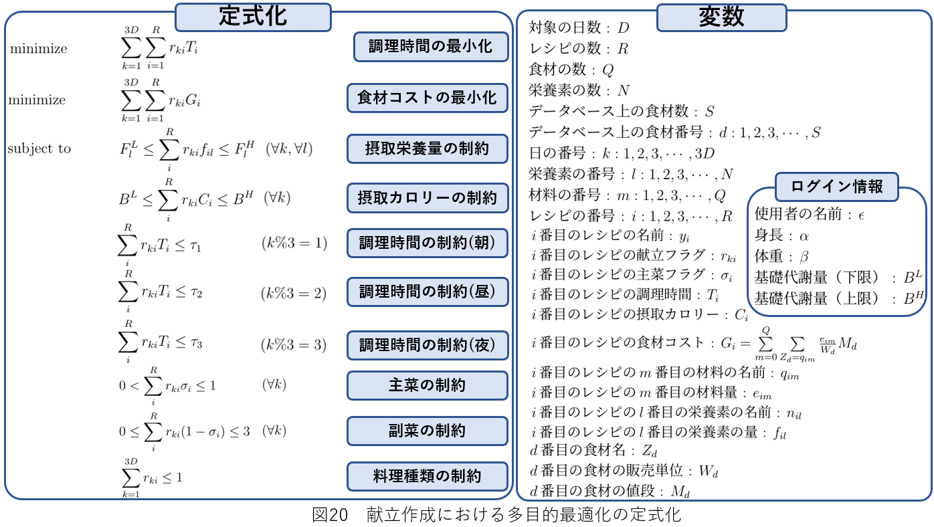
UXを考慮したパレート最適な献立
The objective function is to minimize the cooking time and the cost of ingredients in the menu, and multi-objective optimization is performed using the calorie intake and nutritional intake as constraints.

Slide 12
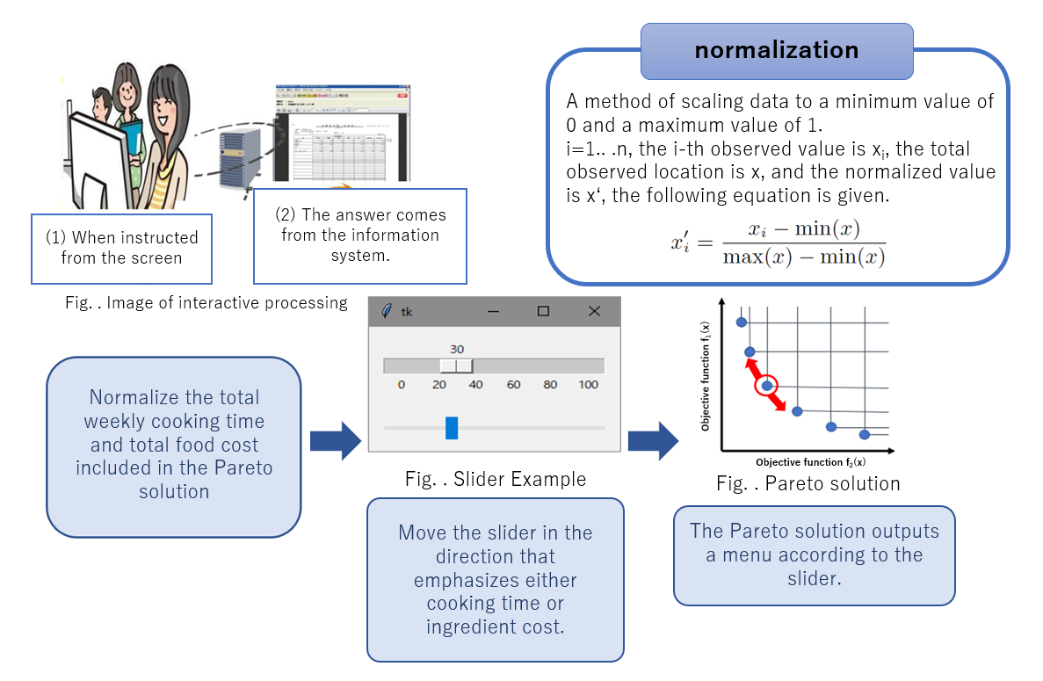
対話による最適な献立の提示
The user selects from Pareto-optimal solutions (recipes) with minimized cooking time and ingredient costs obtained by multi-objective optimization, and the menu is created interactively using Tkinter, with the closer the value is to 0, the more the menu emphasizes minimization of cooking time, and the closer the value is to 1, the more the menu emphasizes minimization of ingredient costs. Create a slider to set the menu to output a weekly menu with the emphasis on minimizing cooking time as the value approaches 0, and a weekly menu with the emphasis on minimizing food cost as the value approaches 1.

Slide 13
提案システムの構成

Slide 14
提案システムの構成

Slide 15
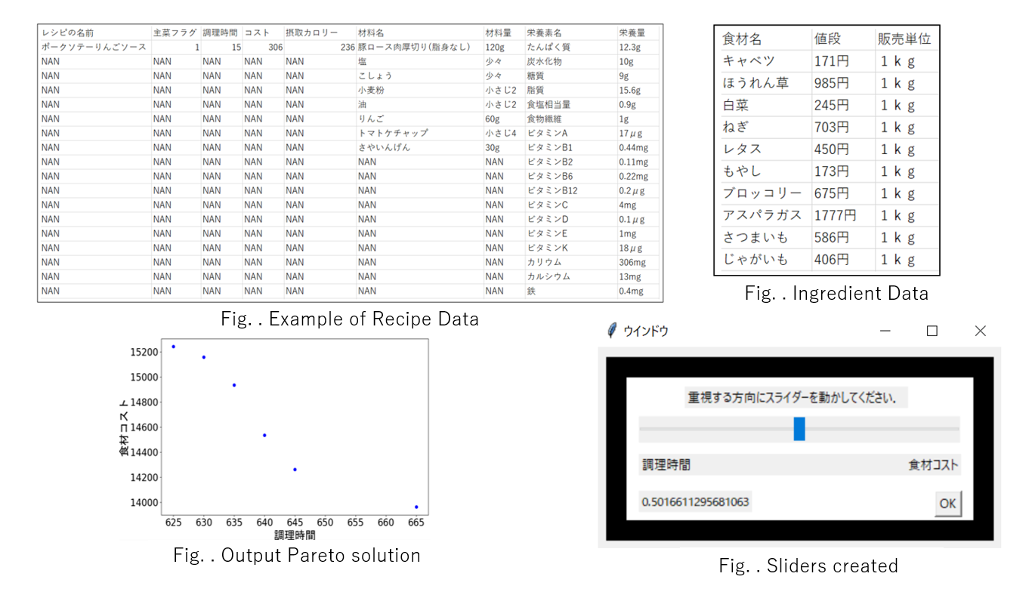
数値実験の概要
Examples of food recipes and ingredient price data stored in the database are shown below. Also shown are the Pareto solution for a week's menu actually created, with the total cost of ingredients and total cooking time set on the vertical and horizontal axes, and the slider used for interactive processing.

Slide 16
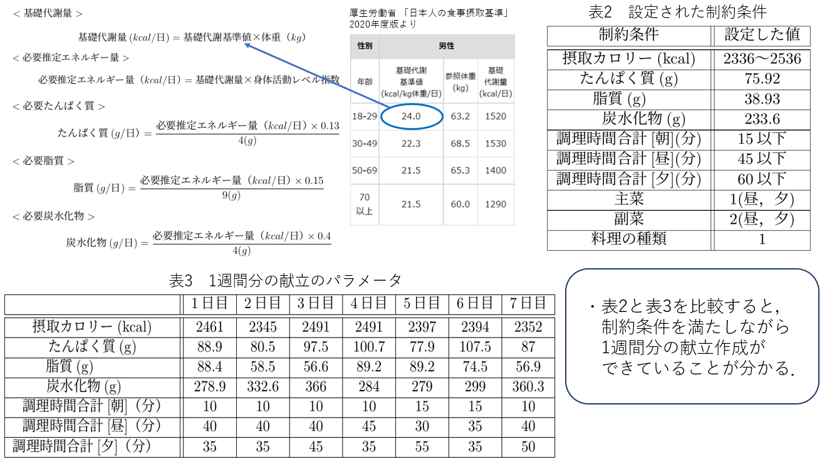
実験結果と考察
自分の身長を160cm，体重を58kg，年齢を23 歳，性別を男，身体活動レベルを普
通として入力とし，1 日に必要な推定エネルギー量を算出し，目的関数と制約条件に
基いて1 週間分の献立作成を行った結果を示す．

Slide 17
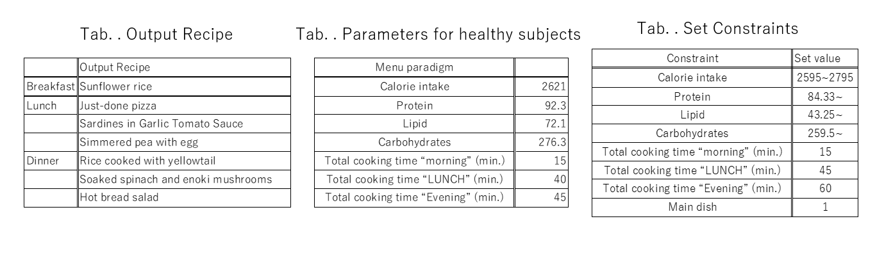
数値実験の結果（健常者）
The following table shows the results of a daily menu planning based on the objective function and constraint conditions.

Slide 18
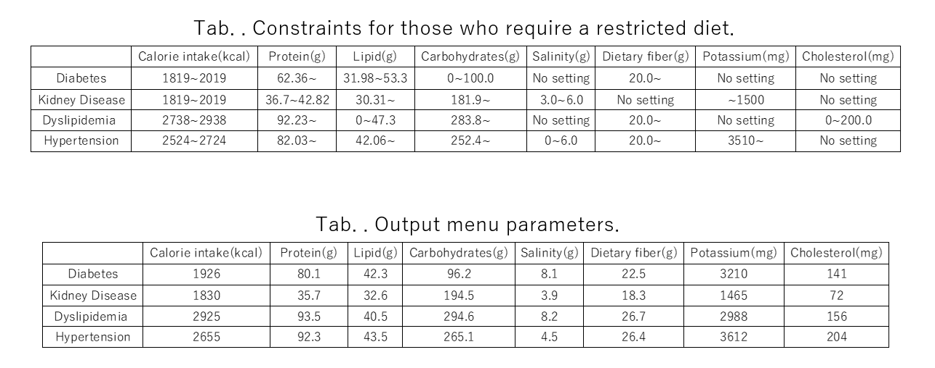
数値実験の結果（制限食）
The following user images were assumed as a model of a person who needs each restricted diet.
・Diabetes: Age 71, male, height 163.1 cm, weight 61.18 kg, low physical activity level
・Kidney disease: age 70, male, height 163.1 cm, weight 61.18 kg, low physical activity level
・Dyslipidemia: Age 45, sex male, height 171.5 cm, weight 102.94 kg
・Physical activity level was low.
・Hypertension: age 37, sex male, height 171.5 cm, weight 88.24 kg, physical activity level low
The constraints and output results are shown below.

Slide 19
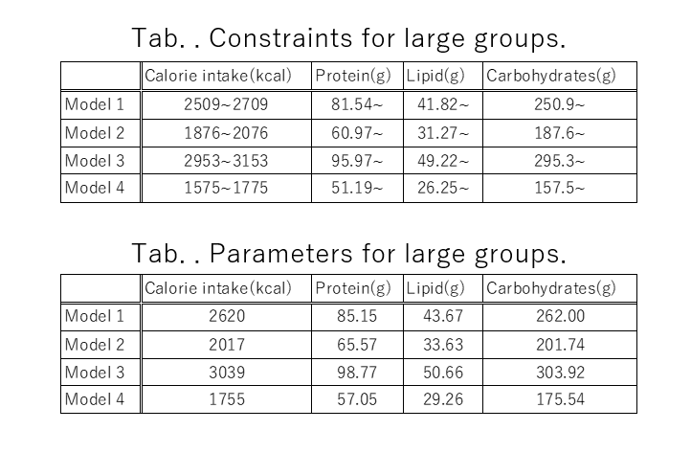
数値実験の結果（大人数）
The following user images were assumed as models for a large group of users.
・Model 1: Age 52, male gender, height 170.8 cm, weight 70.4 kg, physical activity level normal
・Model 2: Age 48, sex female, height 158.3 cm, weight 55.2 kg, physical activity level normal
・Model 3: Age 22, male, height 172.6 cm, weight 64.0 kg, high physical activity level
・Model 4: Age 17, sex female, height 154.8 cm, weight 47.2 kg, low physical activity level
The constraints and output results are shown below.

Slide 20
UXの結果

Slide 21
おわりに

